Slide 1
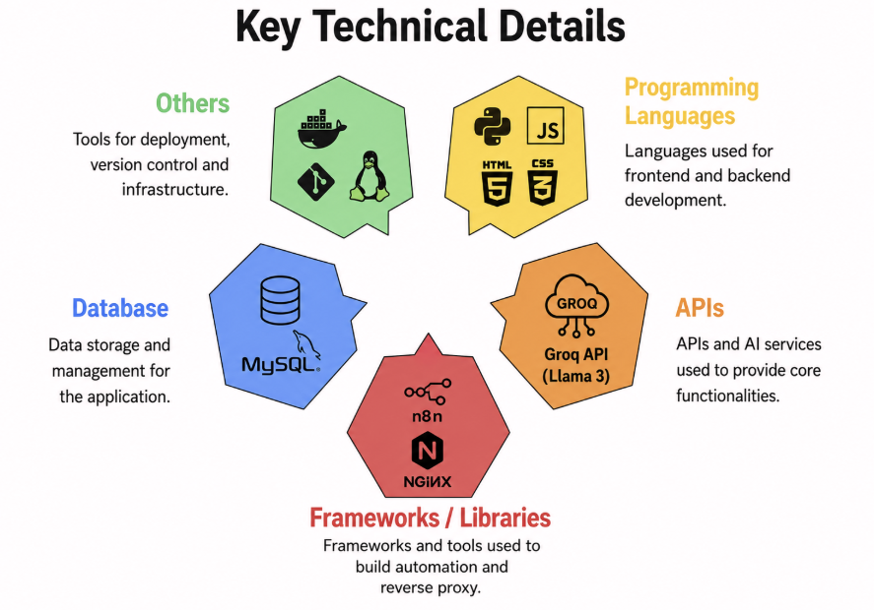
TRÉSOR
Customer Segmentation & Intelligence AI Retail Banking
Problems Addressed
  One-size-fits-all marketing : bank offers savings, credit cards, loans & investments, but promotes them the same way to every customer, leading to low engagement
  Customer data sits unused : rich transaction & spending data exists, but there's no system to turn it into behavioral insights
  No easy way to segment customers : without meaningful groups, personalized product recommendations aren't possible
  No single, conversational entry point : existing tools need segmentation & reporting instead of one simple chat interface
Proposed Solution
  Single AI agent with a natural-language chat interface : no separate dashboards or SQL knowledge needed
  Intent-routed pipeline (Webhook → Router Agent → Security Filter → MySQL → Summarizer) : each query classified and handled by the right path automatically
  Covers 5 intents in one system : direct queries, EDA, explainability, segmentation & safe refusals
  Human-readable insights & personas : turns raw customer data into plain-English summaries and recommendations
  Fully self-contained one-command Docker deployment : MySQL, n8n workflow & frontend all launch together

Slide 2
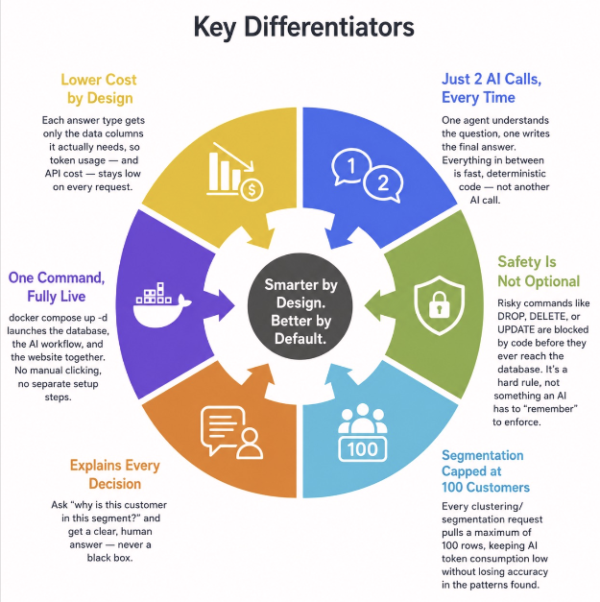
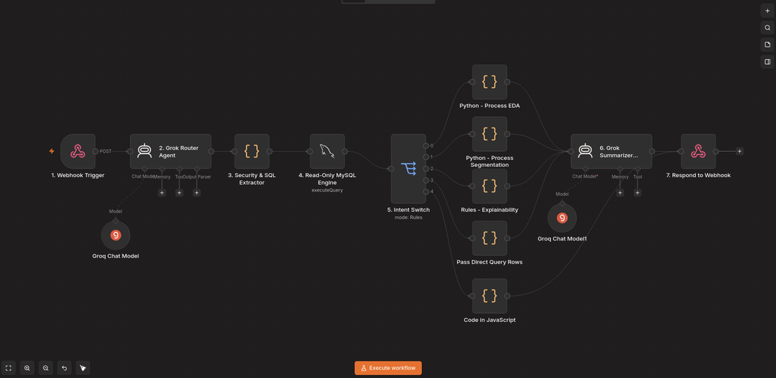
WHAT MAKES THIS SOLUTION STAND OUT?
ARCHITECTURE
Dataset Information
  Source: Kaggle - Credit Card Dataset for Clustering
  File Name: CC GENERAL.csv
  Size: ~9,000 active credit card holders over a 6-month evaluation period.
  Features: 18 behavioral variables per customer.

